Slide 1

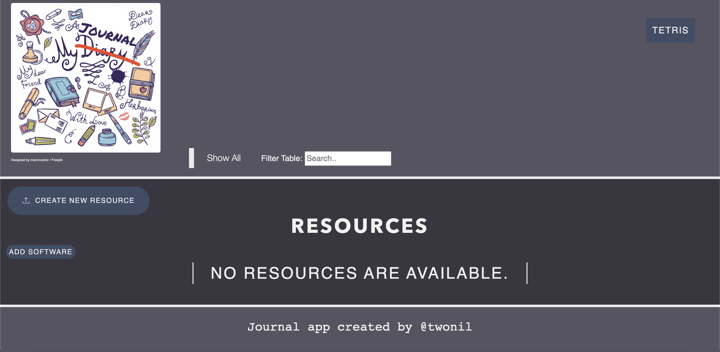

My Journal
Notes:
Hi im nilay, and today I will be presenting the journal app that I have created and it’s various features.
(10s)

Slide 2
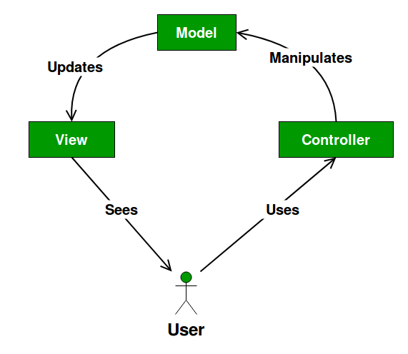
Initialisation
MVP:
A web journal app for storing and accessing resources, via links.
Design:
Using an MVC pattern.
Reason for building this:
To be able to easily find and access any resources I may come across in future, as well as getting to grips with frontend and backend technology, and getting a deeper understanding behind code which will help me with future QA work.
Notes:
As everyone else, the mvp for this was to create a simple journal app that is able to store and recall resources, when the user needs them.
The design plan that we all followed was an MVC pattern as shown on screen, wherein which the user uses the controller, which are the web app functions to manipulate the model, which is within the database in the back end, which then updates the View which is shown to the user in the form of a resource list.
I had a couple of reasons for building this, it’s first is simply so Im able to use the app myself and easily find any resources I come across in the future. However the main reason for this was to get a deeper understanding of how code works and the steps it takes to create an app or piece of software. This would let me have a better understanding of the code ill be testing as I go on as a QA.
(1 min)

Slide 3
User Stories
As an admin,
I want to add a resource via admin portal,
so that it updates on the front-end for the user.
As a user,
I want to delete a resource,
so that it isn’t in the way.
As a user,
I want to search the resource list,
so that I can easily find resources.
As a user,
I want to filter the resource list,
so that I can find resources specific to the software I am using.
As a user,
I want to create a resource,
so that I can use it in the future.
As a user,
I want to edit a resource,
so that I can rectify mistakes.
Notes:
I wrote some user stories for the app in order to get a basic functionality of it and to create some basic test scenarios in accordance to the app, and they are:
(50s)

Slide 4
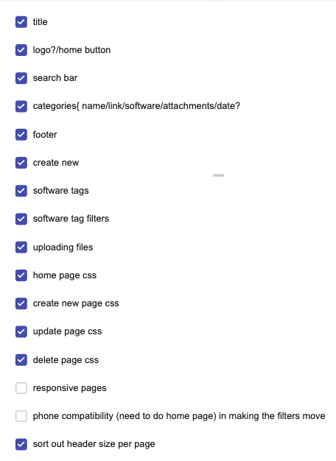
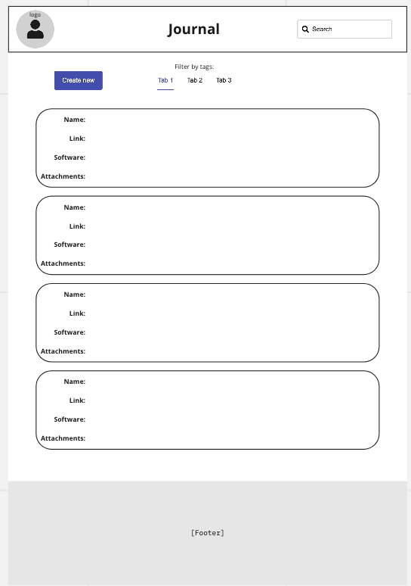
Wireframe
Notes:
I began with a list of functions and pages I wanted for the web app and a to do list for them. I first came up with the first design on the right as a base for the web app, but I decided to against it as I thought it would be quite cluttering and hard to find resources if there were loads of them.
(30s)

Slide 5
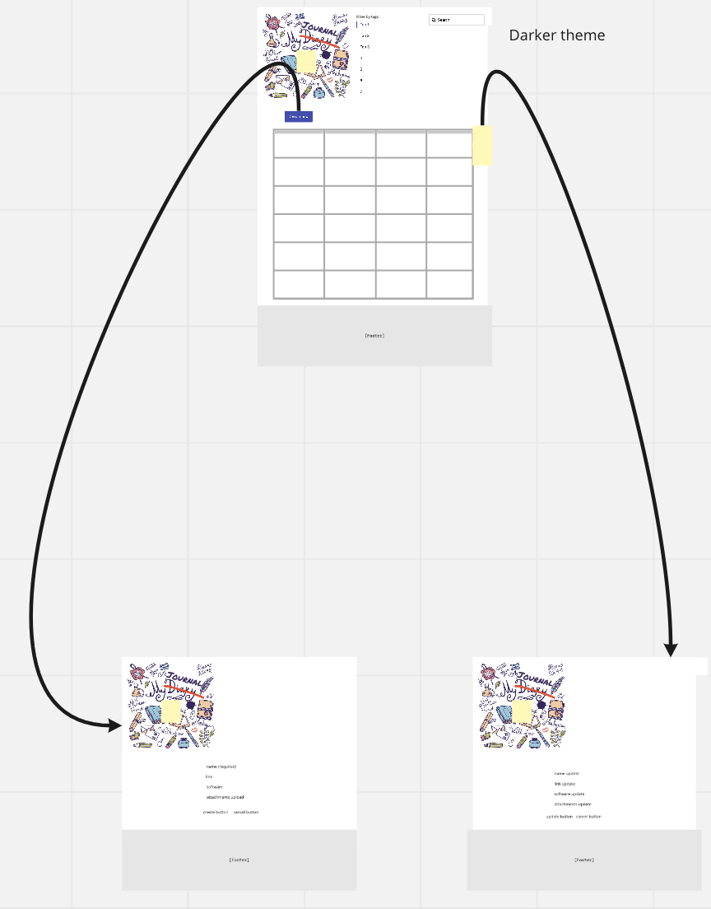
Wireframe
Notes:
I then adapted the original design to the on the left, where yellow squares are indicating specific features, which are the logo taking you to the home page, an edit resource and a delete resource button. The create resource and edit resource page mocks are shown on the right.
I went on to change the look of the app as I created it as certain parts of it weren’t very suitable, for example I decided to move the search bar wit the filters and set the filters horizontally, as it fit the site better when there were a lot of software tags. I also decided on a darker theme as it was easier on my eyes.
(50s)

Slide 6
Demo
My journal app
Notes:
Now I’ll demo the app and its features.
I didn’t have too much time to automate any testing, but I manually tested each feature through the web app and backend myself and wrote some test scenarios that I checked and confirmed to be working.
I’m not gonna read through them as that’ll take quite a while but I’ll leave them on screen for a little while.
(3-4 mins)

Slide 7
Home Page Test scenarios
**As a user, I want to search the resource list, so that I can easily find resources.
****As a user, I want to filter the software tags, so that I can find resources specific to the software I am using.
Given I am on the home page: when I click ‘create new resource’ button, I am redirected to create new resource page.
when I click ‘add software’ button, I am redirected to add software page.
when I click ‘game’ button, I am redirected to game page.
when I scroll to bottom of page, footer reads “Journal app created by Nilay Patel” and “Journal app created by @twonil” at some point.
Given I have resources in the table: **when I use the search bar, the table is filtered to that search.
****when I click a software filter, the table is filtered to those software tags.
when I click a software tag, the table is filtered to those software tags.
when I click a link, I am redirected to the link.
when I click an attachment, the attachment is loaded.
when I click delete button, the page redirects to confirmation page.
when I click edit button, the page redirects to edit resource page.
Given I have no resources in the table: when I look at the page, I get “No resources are available” message.
Given I have added a new software: when I look at the page, I see the new software on the filter tabs.
Given I have deleted a resource: when I look at the table, the selected resource is not present.
Given I have created a resource: when I look at the table, the new resource is present.
Given I have updated a resource: when I look at the table, the existing resource is updated.
Notes:
Here are the test scenarios for the home page that I wrote, and notice the starred ones are related to specific user stories , each of which are again stated at the top of the slide.

Slide 8
Add/Edit Resource Page Test scenarios
**As a user, I want to create a resource, so that I can use it in the future.
****As a user, I want to edit a resource, so that I can rectify mistakes.
Given I am on the add resource page: when I click logo, I am redirected to home page.
when I click ‘game’ button, I am redirected to game page.
when I click create without name, I am told to fill out Name field.
when I click create with an invalid URL in link, I’m told to enter a URL.
when I click choose a file to upload, I’m told the file name to confirm it’s the right one.
when I click cancel, I’m redirected to home page with no new resource added.
**when I click create, I’m redirected to home page with the new resource added.
Given I am on the edit resource page: when I click logo, I am redirected to home page.
when I click ‘game’ button, I am redirected to game page.
when I look at the form, I see it is filled out with corresponding resource information.
when I click update without name, I am told to fill out Name field.
when I click update form with invalid URL in link, I’m told to enter a URL.
when I click choose a file to upload, I’m told the file name to confirm it’s the right one.
when I click cancel, I’m redirected to home page with no new resource added.
****when I click update, I’m redirected to home page with the existing resource updated.
Given I have added a new software: when I click create new resource, I’m able to use the new software tag.
when I click edit resource, I’m able to use the new software tag.
Notes:
These are the test scenarios for the Create new resource page and the edit resource page.

Slide 9
Delete Resource/Add Software Page Test scenarios
**As a user, I want to delete a resource, so that it isn’t in the way.
Given I am on the delete resource page: when I click logo, I am redirected to home page.
when I click ‘game’ button, I am redirected to game page.
when I look at the page, I see “Are you sure you want to delete this resource?”.
when I look at the page, I see the corresponding resource information.
when I click cancel, I’m redirected to home page with the existing resource still there.
**when I click confirm, I’m redirected to home page with the existing resource deleted.
Given I am on the add software page: when I click logo, I am redirected to home page.
when I click ‘game’ button, I am redirected to game page.
when I click submit without a software tag, I am told to fill out field.
when I click cancel, I’m redirected to home page with no new software added.
when I click submit, I’m redirected to home page.
when I click submit with an existing software tag, I’m not redirected and software isn’t duplicated.
Notes:
Here are the test scenarios for the delete resource confirmation page, and the add software page.

Slide 10
Admin Page Test Scenarios
**As an admin, I want to add a resource via admin portal, so that it updates on the front-end for the user.
Given I have created a resource through admin portal: **when user views home page, they can see newly added resource.
Given I have edited a resource through admin portal: when user views home page, they can see newly updated resource.
Given I have deleted a resource through admin portal: when user views home page, they can’t see old resource.
Given I have added a software through admin portal: when user views home page, they can see new software filter.
when user creates resource, they can use new software tag.
when user updates resource, they can use new software tag.
when user adds software, they can’t use new software tag.
Notes:
Here are a few cross site test scenarios that I wrote for the admin page and the front end. I have done a few quick end to end tests for the top 3 of these scenarios, and here is a screen recording of these tests.
Slide 7-10: (2 mins)

Slide 11
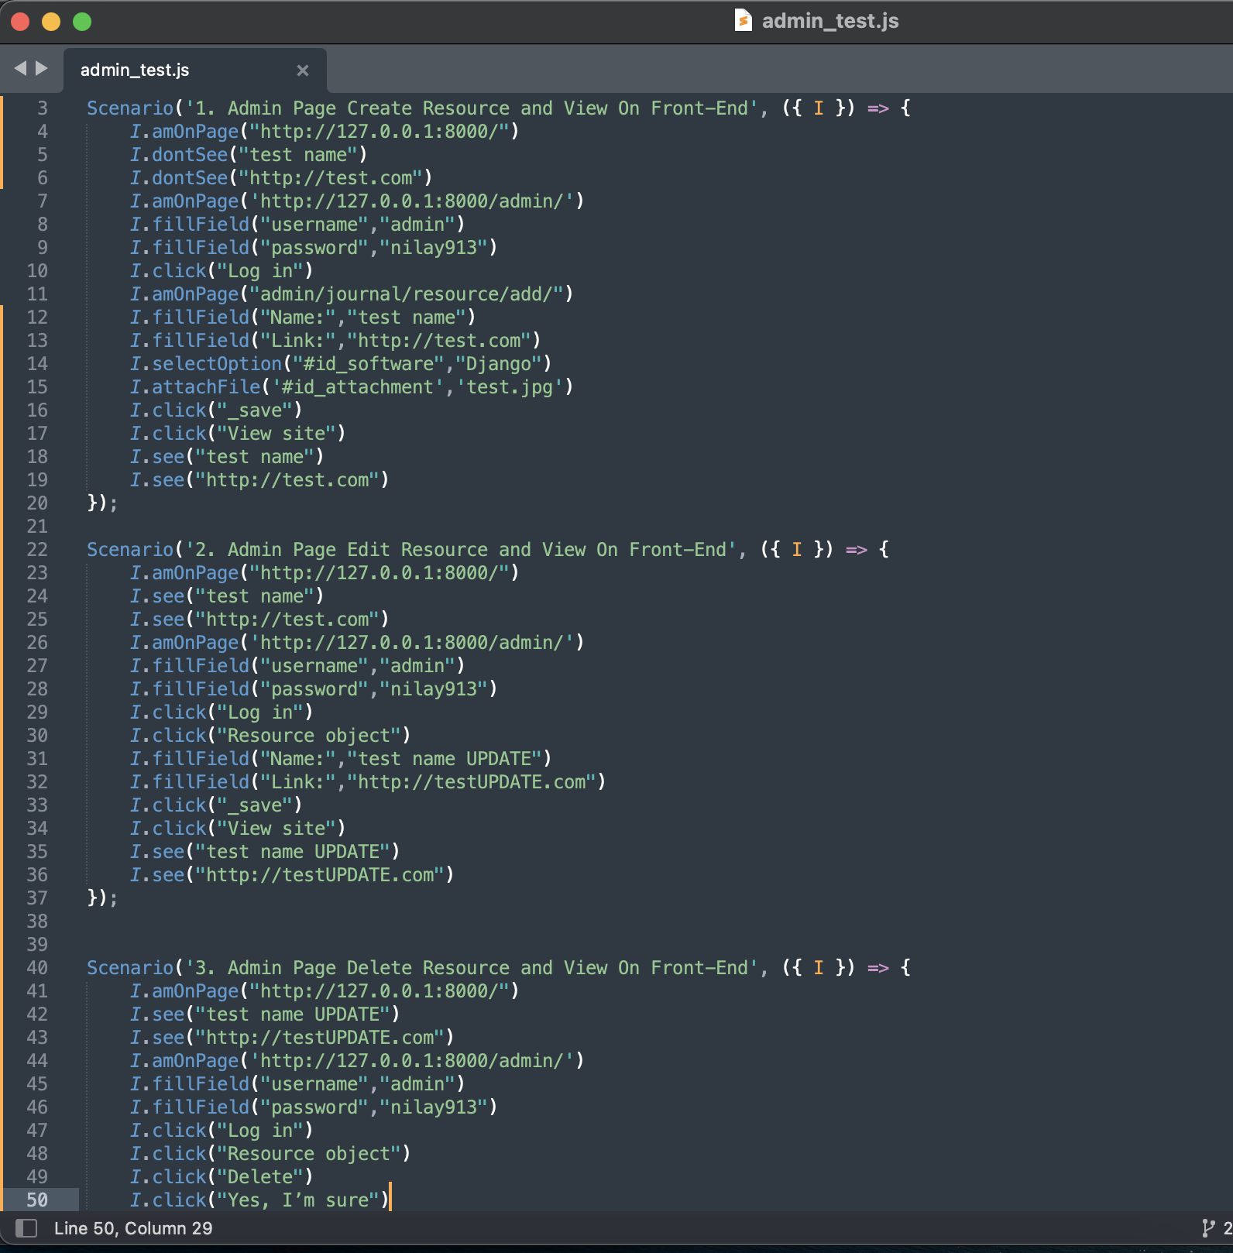
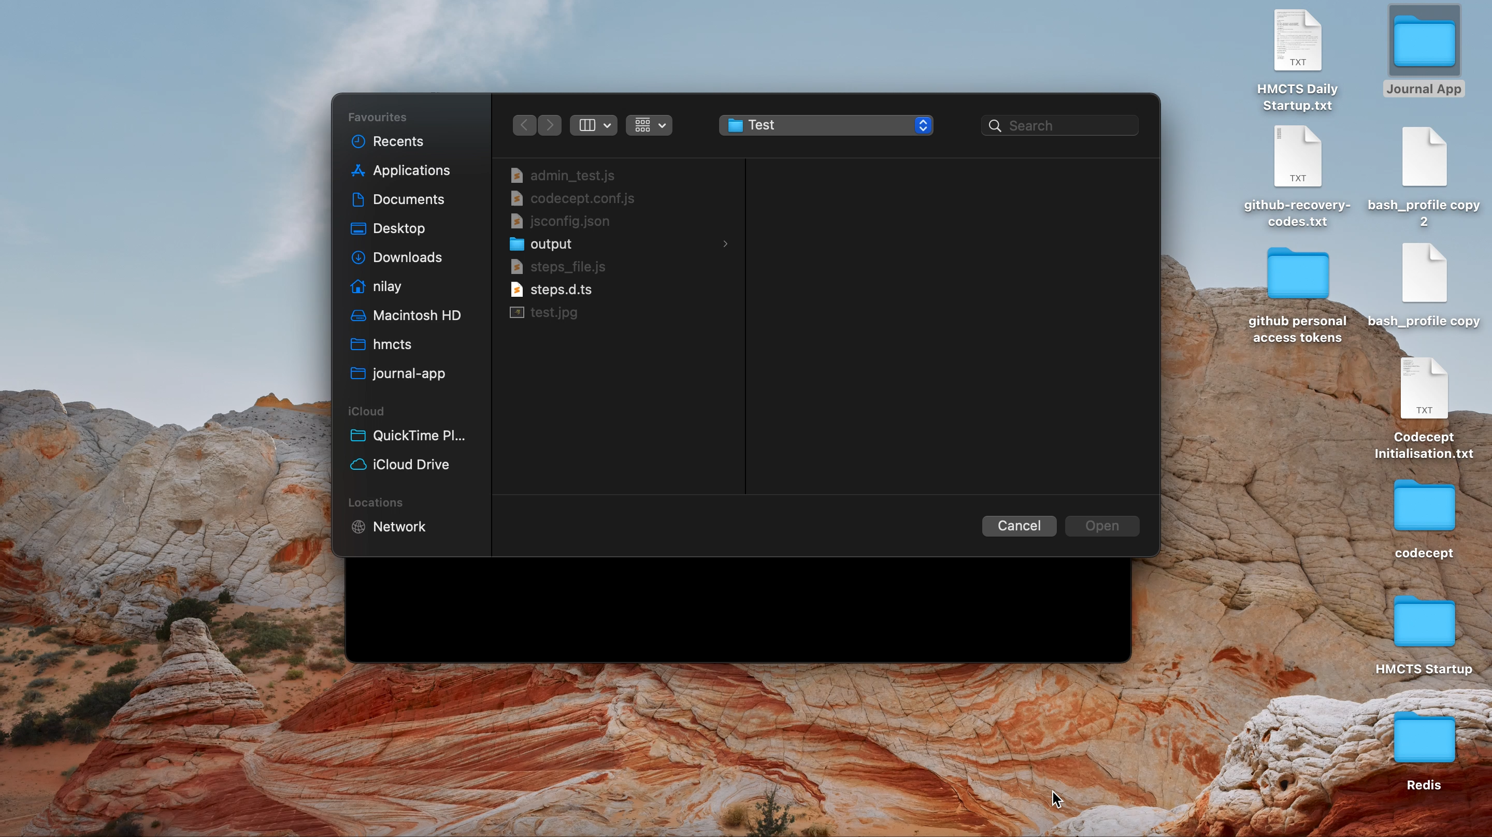
Admin Page Test
Notes:
I did these tests through codeceptJS using playwright as a helper, on the left you can see the code I ran and what it does, and on the right is a screen recording of me running these tests.
[pause through recording to explain each step ?]
(1.5 mins)

Slide 12
Future Improvements
Make the home page phone compatible.
Make home page more responsive to window size change.
Add a nav bar.
Create account feature so individuals can have access to their own private resource list / deploy the app.
Error messages when software tag already exists.
Search softwares when creating or updating a resource
Notes:
If I had longer to spend on this project, I would try to implement some more improvements and features. Id like to make the web app more responsive to window size change and make it phone compatible, as of now most of it is, however the home page table and the header aren’t very compatible.
I’d also like to include a nav bar at the top of the page to take to each individual page for ease.
A create account feature with sign up and log in forms would be useful, so others could also use the app and have their own individual resource list and of course this would mean actually deploying the app so its accessible to other people.
A minor improvement Id like to make is that right now when you add a software that already exists, it just leaves it on the same page, but id prefer an error message to pop up informing the user that the tag already exists, as well as being able to search softwares in the creating resource and updating resource form.
(1.5 mins)

Slide 13
Q&A
Notes:
Thank you for listening to my presentation, are there any questions?
12.5-13.5 mins

